Slide 1
Digital Imaging and Design
Dr. Janey HUANG

Slide 2
Instructor's contact info
Office: CC505
Email: janeyhuang@uic.edu.cn
Student Consultation: Wednesday 1-3 pm (please make appointment via email for confirmation)

Slide 3
AIMS & OBJECTIVES
This course will introduce students to the fundamental practices in digital (computer) graphic design in both the art and design worlds through serial lectures, demonstrations, and workshops.

Slide 4
Software & materials
Adobe Illustrator
Adobe Photoshop
A sketch book & pencil

Slide 5
Study Requirements & Teaching Methods
Grading is one component of the system of evaluation and feedback concerning a student’s progress. In this course, your performance will be based on a range of criteria including:

Slide 6
Study Requirements & Teaching Methods
Review individual student’s work
Mastery of basic skills
Quality of work
Execution of key notions and concepts

Slide 7
Study Requirements & Teaching Methods
Class time efforts
Class attendance
Deadlines in this class are not flexible

Slide 8
Study Requirements & Teaching Methods
Energy and effort put forth (and relation of that effort to the content of student’s work)
Class participation and interaction with other students

Slide 9
Attendance
Consistent attendance is essential for the successful completion of this course. All students are expected to attend class regularly. A strong attendance record demonstrates a commitment to established goals.

Slide 10
Attendance
You should obtain any missed lecture notes from a classmate and contact the instructor about any assignment. It is your responsibility to explain your absence to the instructor.

Slide 11
Attendance
Students are expected to arrive on time for all classes. Any student arriving after the scheduled beginning time for class will be considered late and three such occurrences equal one absence for the course. Students arriving after 15 minutes late will be counted as absent even if they attend the remainder of the class session.

Slide 12
Late Assignments
If an assignment is turned in late 10% of the total score will be deducted per day. If an assignment is more than 3 days late it will receive an automatic “0”.

Slide 13
Grading
In-class Participation 10%
Assignments x 5 50%
Group presentation 20%
Final Project 20%

Slide 14
Assignments
Color squares solutions
Creative words play
Illustration with color matching
Logo re-design
Magazine front cover design

Slide 15
Final project
Poster design X 2

Slide 16
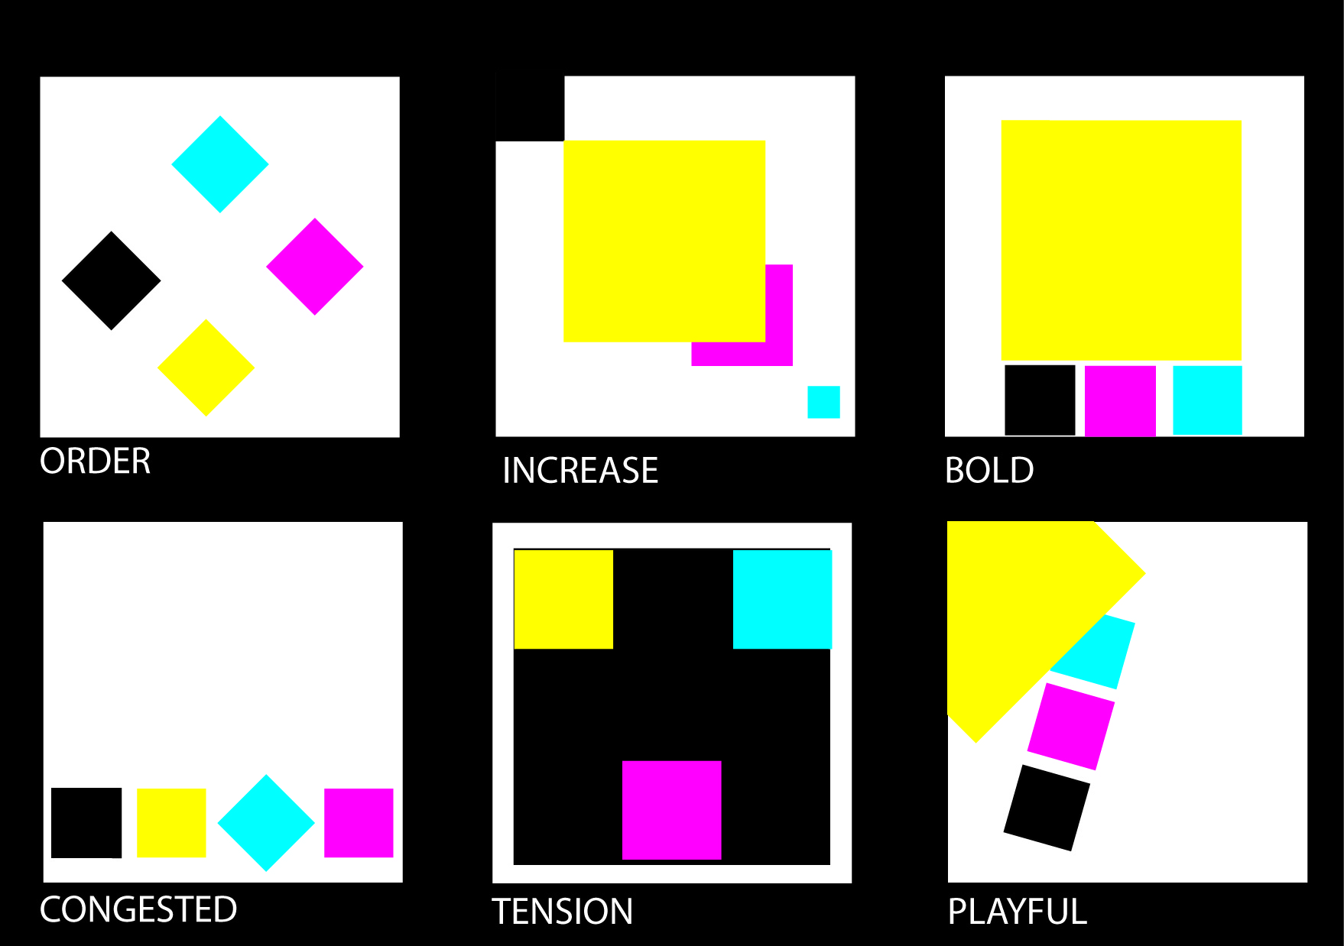
Example of assignment

Slide 17


Example of assignment

Slide 18


Example of assignment

Slide 19
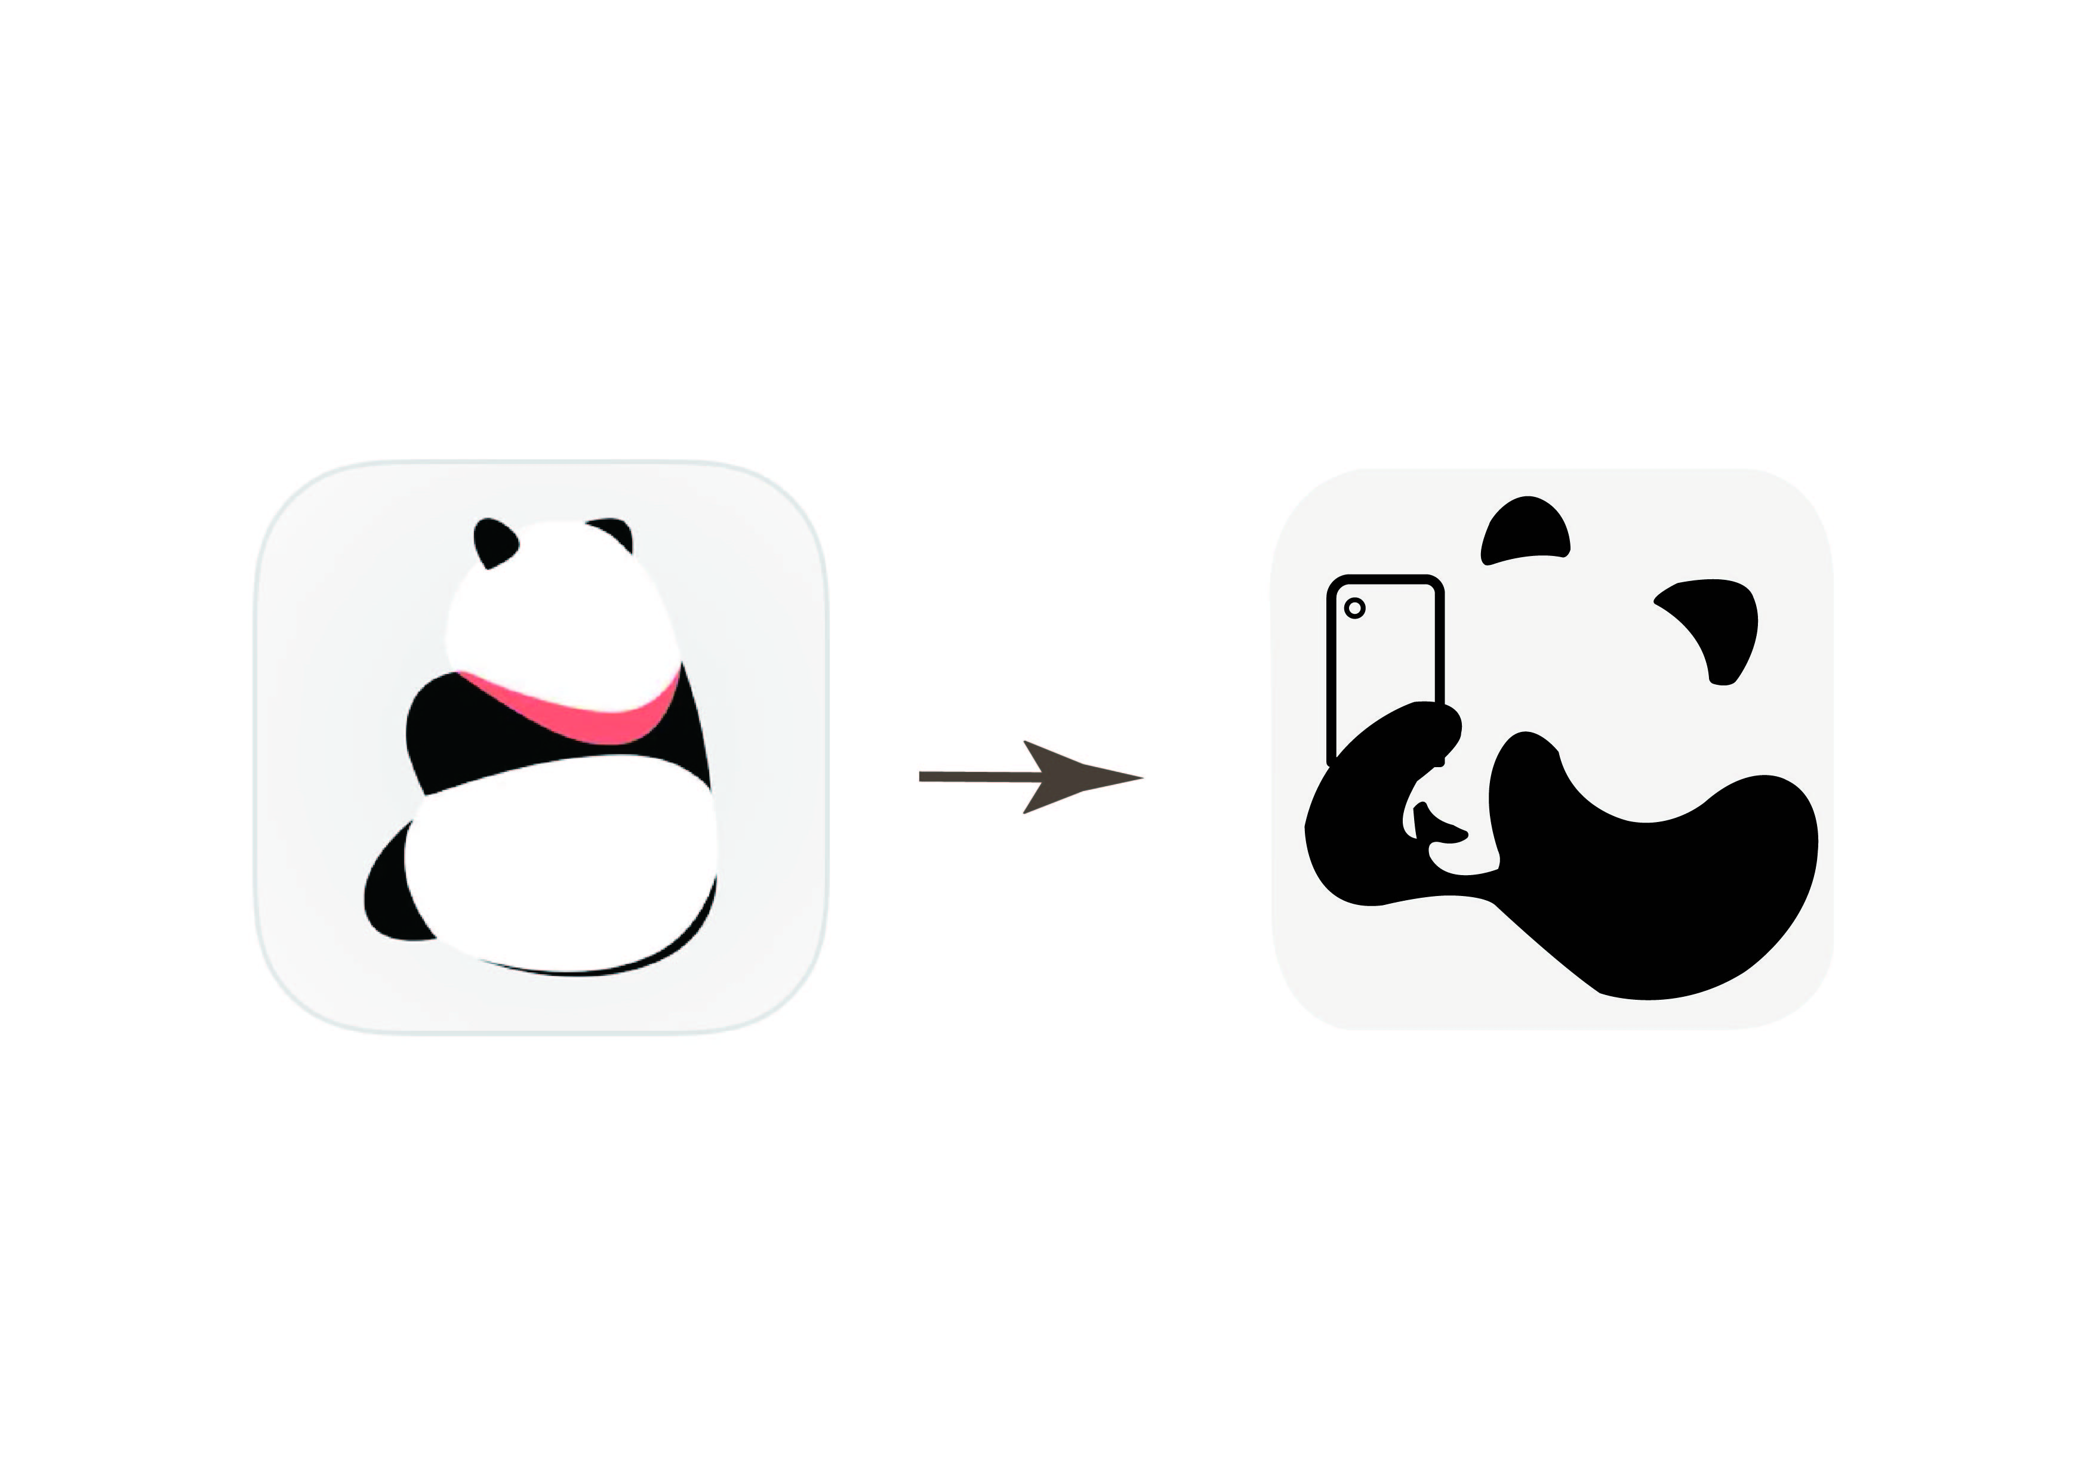

Example of assignment

Slide 20


Example of assignment

Slide 21
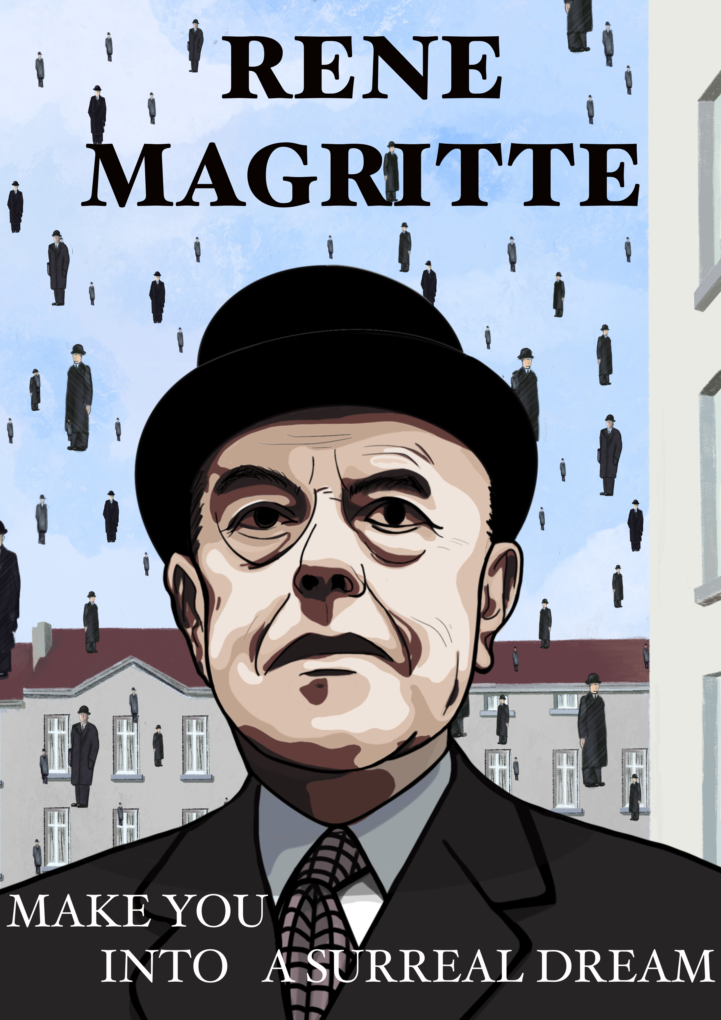

Example of assignment

Slide 22


Example of assignment

Slide 23
Group presentation: Understanding Color Psychology
10: Black
11: White
12: Pink
14: Red
15: Brown
4: Orange
5: Yellow
6: Green
7: Blue
8: Purple

Slide 24
Presentation requirements
List down all members’ names (Chinese Pinyin) on the first slide
Copy your PPT on the desktop of the classroom’s computer before class
3-4 Students in a group
Duration: 20 minutes presentation + 10 minutes Q & A

Slide 25
Presentation requirements
Introduce the color and its meanings
Effects of the color on emotions
Functions of the color
Use examples to support your points (video, images etc)
You are free to add additional perspectives on the contents

